Slide 1


Week 3:LLVM Backend
Mohamed Ashraf-Iyad Wael
28 July 2025

Slide 2
What is LLVM Backend (llc)
The LLVM backend is responsible for converting LLVM Intermediate Representation (IR) into executable machine code specific to a target architecture. This transformation involves multiple low-level processes such as instruction selection, register allocation, and instruction scheduling, all of which are crucial for generating optimized and correct binary output.
Unlike frontends, which are generally source code dependent, the backend is inherently tied to hardware characteristics. It understands the instruction sets, registers, calling conventions, and performance constraints of real-world processors like x86, ARM, or RISC-V.
The goal of the backend is not just correctness, but also efficiency. A good backend must emit compact and performant machine code, taking advantage of the target’s capabilities while respecting constraints like register pressure and instruction latency.

Slide 3
LLVM Backend Pipeline
The LLVM backend consists of several stages, each transforming or optimizing the program toward the goal of producing efficient machine code. This process begins with IR Legalization and ends with binary code emission.
The code generation has the following stages:
Instruction Selection: The input LLVM IR is mapped to instructions in the target instruction set. At this stage, the program is using an infinite set of virtual registers and abstract references to the function call stack.
Scheduling and Formation: Determines an ordering of the instructions. Just to be clear, there was already an ordering to the instructions at the instruction selection stage, but here we can choose to reorder some of those instructions depending on the register allocation strategy or the instruction latencies.

Slide 4
LLVM Backend Pipeline
SSA-based Machine Code Optimizations: Performs stuff like peephole optimizations.
Register Allocation: Maps the virtual register to physical registers.
Prolog/Epilog insertion: Inserts the machine instructions at the beginning (or prolog) and end (or epilog) of every function. These would typically be instructions that extend the stack when entering a function or return to the caller. Abstract stack references are also resolved since the stack size is known at this stage.
Late Machine Code Optimizations: Probably self-explanatory.
Code Emission: Emits the object or assembly code.

Slide 5
LLVM Backend Pipeline Instruction Selection
Instruction selection is the process of mapping LLVM Intermediate Representation (IR) into target-specific machine instructions. At this stage, the IR still uses an infinite set of virtual registers and abstracts away machine-specific concerns.
LLVM supports two main frameworks for instruction selection: SelectionDAG and GlobalISel. Selection DAG converts the IR into a Directed Acyclic Graph (DAG) structure, GlobalISel is a newer, more modular approach that works directly on LLVM’s Machine IR and supports more complex transformations.
The output of this stage is a list of target-specific machine instructions that represent the semantics of the original IR. These instructions are still using virtual registers and abstract stack references, allowing later stages more freedom for reordering and register assignment.

Slide 6
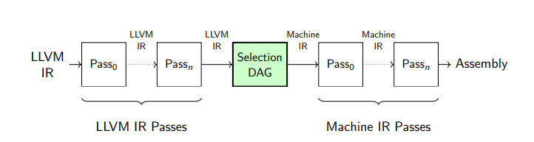
LLVM Backend Pipeline Instruction Selection(Selection DAG)
This is the bridge between LLVM IR and the target-specific Machine IR.
In this stage, LLVM takes the optimized LLVM IR and lowers it to target instructions using a Directed Acyclic Graph (DAG) structure.
This DAG represents operations and dependencies in a way that allows efficient pattern matching to map abstract operations to target-specific machine instructions.

Slide 7
LLVM Backend Pipeline Instruction Selection(Selection DAG)
This is the bridge between LLVM IR and the target-specific Machine IR.
In this stage, LLVM takes the optimized LLVM IR and lowers it to target instructions using a Directed Acyclic Graph (DAG) structure.
This DAG represents operations and dependencies in a way that allows efficient pattern matching to map abstract operations to target-specific machine instructions.

Slide 8
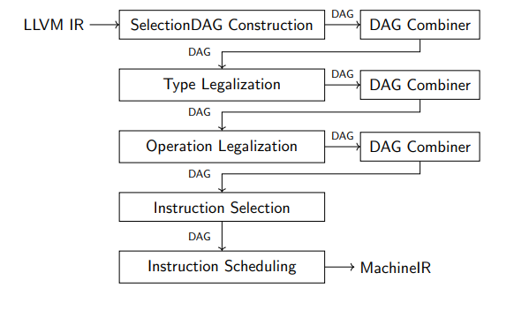
LLVM Backend Pipeline Instruction Selection(Selection DAG)
SelectionDAG Construction:The process begins with converting LLVM IR into a SelectionDAG, a Directed Acyclic Graph where nodes represent operations and edges represent data dependencies.
Type Legalization:Not all target architectures support all data types (e.g., 128-bit integers). So LLVM must legalize types—i.e., break down unsupported types into smaller legal ones (e.g., a 128-bit integer into two 64-bit).
Operation Legalization:A target may not support certain operations this replaces illegal operations with legal sequences of supported instructions (e.g., converting a division into a multiply + shift).

Slide 9
LLVM Backend Pipeline Instruction Selection(Selection DAG)
Instruction Selection: Now that the DAG is composed only of legal types and operations, this stage maps DAG nodes to real machine instructions by using TableGen-defined patterns to match DAG patterns to target-specific instructions (e.g., mapping add node to ADD r0, r1, r2). The output DAG now contains specific instructions but still in DAG form (not yet linear).

Slide 10
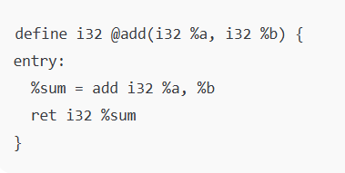
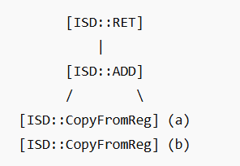
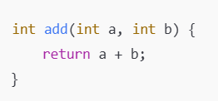
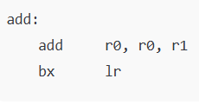
LLVM Backend Pipeline Instruction Selection(Selection DAG)

Slide 11
LLVM Backend Pipeline Scheduling and Formation
Scheduling takes the machine instructions generated during instruction selection and determines a good execution order. Although the instructions may already be ordered in some logical fashion, this stage can reorder instructions based on the constraints and opportunities of the target machine.
LLVM uses a scheduling DAG to model data dependencies between instructions.
The result of this stage is a legal and optimized instruction order that adheres to the constraints of the target CPU. This new ordering may expose more opportunities for coalescing or removing redundant instructions in the next optimization passes.

Slide 12
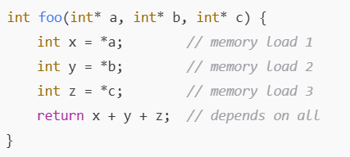
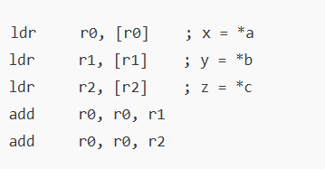
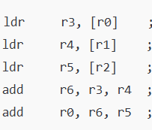
LLVM Backend Pipeline Scheduling and Formation(scheduling DAG )
Each node represents a machine instruction, and the edges encode dependencies like register reads/writes or memory accesses. The scheduler respects these dependencies while trying to minimize pipeline stalls and utilize instruction-level parallelism (ILP). It also considers whether certain instructions can be issued in parallel on superscalar architectures.

Slide 13
LLVM Backend Pipeline SSA-based Machine Code Optimizations
At this stage, the Machine Instructions are still in SSA (Static Single Assignment) form, which facilitates machine-level optimizations that are not feasible earlier. SSA form ensures each virtual register is assigned exactly once, which simplifies dataflow analysis and transformation.
Peephole optimizations involve looking at small windows (or "peepholes") of code to find short sequences that can be replaced with more efficient equivalents. For example, an add x, 0 could be removed entirely, or a mov r1, r2 followed by mov r2, r1 might be eliminated. These local transformations improve code quality without needing global context.
This phase improves the cleanliness and efficiency of the instruction stream before physical register pressure forces compromises. It acts as a bridge between high-level correctness and low-level optimization, and it has a measurable impact on the final code size and performance.

Slide 14
LLVM Backend Pipeline SSA-based Machine Code Optimizations(Peephole)
Peephole optimization is a local optimization technique that looks at small windows ("peepholes") of instructions and replaces inefficient sequences with faster/simpler ones.
These are target-specific and operate on Machine Instructions, not on LLVM IR.
LLVM performs SSA-based optimizations not only at IR level but also during code generation through Machine SSA Form, before final lowering.

Slide 15
LLVM Backend Pipeline SSA-based Machine Code Optimizations(Peephole)
Redundant Instruction Elimination
Ex :- %1 = add i32 %a, 0 ; redundant, just use %a
Combine Instructions
Ex:- replace mov rax, 0; add rax, rbx → mov rax, rbx
Fold Loads/Stores
If a load is immediately followed by an operation, and the architecture supports load+op, combine them.
Strength Reduction
Replace expensive ops like mul by powers of 2 with shl.
Copy Propagation
Eliminate unnecessary copies if the SSA version already exists.

Slide 16
LLVM Backend Pipeline Register Allocation
In this critical stage, LLVM maps virtual registers (used so far) to physical registers provided by the target CPU. Since hardware has a limited number of physical registers, this process must be handled carefully to avoid spilling (storing data in memory).
LLVM supports multiple allocators, but the greedy allocator is widely used for its balance of performance and simplicity.
Register allocation significantly impacts performance because spilled values require extra memory accesses. The more effective the allocator is in keeping values in registers, the faster the final program will run. After this step, the code now uses concrete, real hardware registers.

Slide 17
LLVM Backend Pipeline Register Allocation (Greedy allocators)
It uses a linear scan strategy to walk through the "live intervals" of registers and try to assign them physical registers without conflict. If a conflict arises and no free physical register is available, the allocator decides which value to "spill" based on cost models.
The greedy allocator also includes register coalescing to eliminate unnecessary copy instructions (e.g., moving data between virtual registers that could be assigned the same physical register). It is designed to scale well for large functions and interact smoothly with the instruction scheduler.

Slide 18
LLVM Backend Pipeline Prolog/Epilog Insertion
Once registers are allocated and the stack layout is known, LLVM inserts prolog and epilog instructions at the beginning and end of each function. These instructions manage the call frame: setting up and tearing down stack space, saving and restoring callee-saved registers, and handling function return.
The prolog typically includes instructions to extend the stack (e.g., adjusting the stack pointer), save important registers to the stack, and set up the base pointer if needed. The epilog does the reverse: it restores the stack pointer and any saved registers before returning to the caller.
This stage ensures that generated functions obey the platform’s calling convention and interact correctly with external code, enabling interoperability with other functions and libraries.

Slide 19
LLVM Backend Pipeline Late Machine Code Optimizations
At this point, the program is nearly ready for emission, but LLVM performs late-stage optimizations that benefit from all earlier knowledge, such as actual register assignments and real stack offsets.
Because the machine code is now fully concretized, certain optimizations that would have been unsafe earlier become valid. For example, known register values or immediate values may enable constant folding or instruction simplification. Additionally, instruction sequences may now be safely replaced with faster alternatives if all their operands and effects are known.
Though minor in scope, these final cleanups help ensure the emitted code is compact, efficient, and fully tuned for the specific hardware.

Slide 20
LLVM Backend Pipeline Code Emission
The final stage of the LLVM backend is code emission, where all the machine-specific instructions, register assignments, and resolved memory addresses are converted into binary object code or assembly text.
The result is a fully-formed object file or assembly file that can be linked into an executable binary. For JIT (Just-In-Time) compilation, this might instead be directly emitted into memory and executed.
This stage finalizes the transformation from high-level IR to low-level executable code. A well-optimized backend ensures that the output is both correct and fast, ready to run on the target machine with minimal overhead.

